Slide 1
Project Idea
Genre Classification: A Machine Learning Based Comparative Study of Classical Bengali Literature
Group No. 12
Asadullah Al Galib - 21266015
Satabdi Rani Debi - 22266016
Maisha Mostofa Prima - 22266007
Nayema Ahmed - 20101469
MD Muntasir Mahadi - 20101516
Adib Muhammad Amit- RA
Ehsanur Rahman Rhythm - ST

Slide 2
Introduction
Bengal's literary zenith in the 19th century
Notable writers: Kazi Nazrul Islam, Rabindranath Tagore
Exploration of ancient Bengali literature
Diverse styles and themes in Bengali poetry
Drama as a vibrant subgenre
Understanding the significance of Bengali literature

Slide 3
Literature Review
Book Genre Categorization Using Machine Learning Algorithms (K-Nearest Neighbor, Support Vector Machine and Logistic Regression) using Customized Dataset
Three machine learning algorithms: KNN, SVM and LR
Genre Identification and the Compositional Effect of Genre in Literature
Machine learning and deep learning algorithms: CNN, LSTM, HAN, Naive Bayes, KNN, Random Forests and XGBoost
Statistical and Deep Learning Approaches for Literary Genre Classification
Machine learning algorithms: Random Forest, Naïve Bayes, and SVM
Deep learning approaches : LSTM, CNN, RNN and BERT
Learning meters of Arabic and English poems with RNN

Slide 4
Literature Review
Analysis on capturing user sentiments for online movie reviews Using Machine Learning Algorithms
Three machine learning algorithms: Bayesian, naïve Bayesian, and support vector machine classifiers
News Articles classification Using machine learning techniques
Three classifiers (Decision Tree, Support Vector Machine, and k-nearest neighbor)
The Support Vector Machine (SVM) classifier achieved the highest accuracy compared to the other classifiers

Slide 5
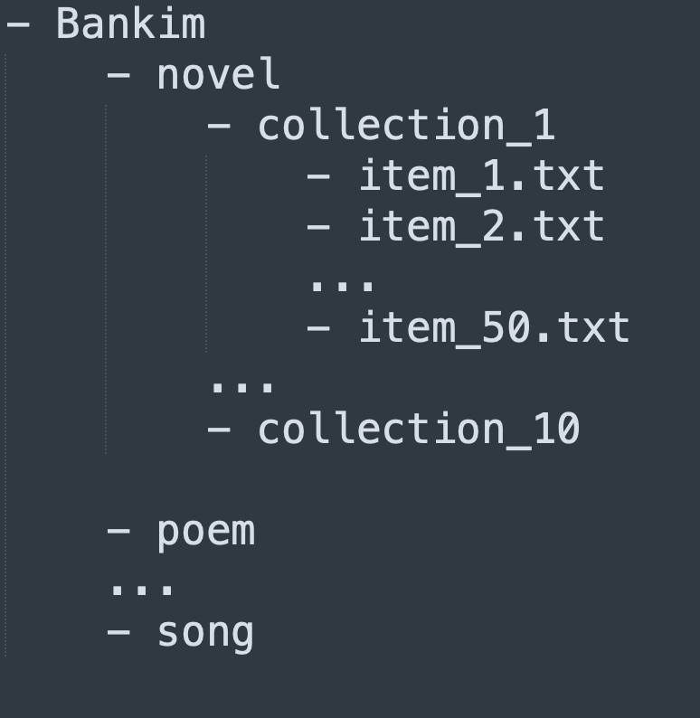
Dataset Compilation & Preprocessing
Lack of quality datasets compiled from authentic sources.
Datasets not available in usable formats.
Crawl, collect, aggregate, preprocess and upload authentic datasets.
Genres: Novel, poem, song, story, essay, drama, and others.
Content hierarchy for each author:
Genre landing page
Collections
Individual paginated items
Crawler able to handle complex and dynamic content hierarchy.
Preprocessing: Removing special symbols, page numbers, repetitive title names.
Aggregate all items into a single JSON or CSV file.

Slide 6
Methodology
Dataset analysis to compile a comprehensive collection of Bengali classical literary texts
Building baseline models (SVM and Naive Bayes) for genre classification as performance benchmarks.
Training deep learning models (e.g., RNN, Transformer) tailored to the characteristics of Bengali classical literature
Analyzing results by evaluating metrics like accuracy, precision, recall, and using confusion matrices and classification reports
Discussing future directions, including advanced pre-training techniques and exploring related tasks like sentiment analysis or authorship attribution, to advance NLP in Bengali classical literature

